Slide 1

Veterans of Foreign Wars
Department of California
VFW Mighty 1st District
POST COMMANDER

Slide 2

Congratulations on becoming
Post Commander!
What exactly does that mean? And what should I be doing now?
Let’s begin with the broad, then roll into specifics.

Slide 3

Use your skillsets
You were elected for a reason.
Are you a good listener, peacemaker, reasonable person?
How are your organizational skills? Do you have the pulse of your community? Do you know what your members are looking for in a Post?
These skills, along with understanding the VFW programs and By-laws will make this year a successful one!
This Photo by Unknown Author is licensed under CC BY

Slide 4

Resources USE THEM!
There are some key resources you need to get familiar with:
READ YOUR POST BY-LAWS and HOUSE/CANTEEN RULES!
Read National’s BY-LAWS and Manual for Procedure
Read the District Commander’s binder and emails!
Familiarize yourself with the VFW Dept CA Guide to Disciplinary Action
VFW CA and National both have Resource/Training sections on their websites, as well as your Membership stats, and program info!

Slide 5

Build your team! Look ahead for the future!
Looking at your long-term calendar and setting Chairman for events and programs is a key. There is a lot due in the first half of the year.
Get the right person for the right job – Chairman are how you manage “everything” with out having to manage “everything”. Look at the talents of your membership and find the person you know will support you and the Post. You are automatically on every committee the Post has.
Organize and plan – Communication, this will make or break you! Don’t be the leader with a secret. Your line officers, Your House Committee, Your Auxiliary. It doesn’t do any good to have Chairman if you are not talking to them.
Use District resources. Contrary to popular belief, we are here to help!
This Photo by Unknown Author is licensed under CC BY-NC

Slide 6

Reporting
Now that you have a plan, and the right people in place -report your efforts!
Reporting shows your Post is being a Post and not a bar!
Review the Dashboard on the Dept of CA website. Check here to track Good Standing requirements, Program reporting, Buddy Poppy and membership drives etc.
Look over your Recruiting Plan, have you followed YOUR plan?
Reporting can be done by anyone, but you are responsible to see that it is getting done.
This Photo by Unknown Author is licensed under CC BY-NC-ND

Slide 7
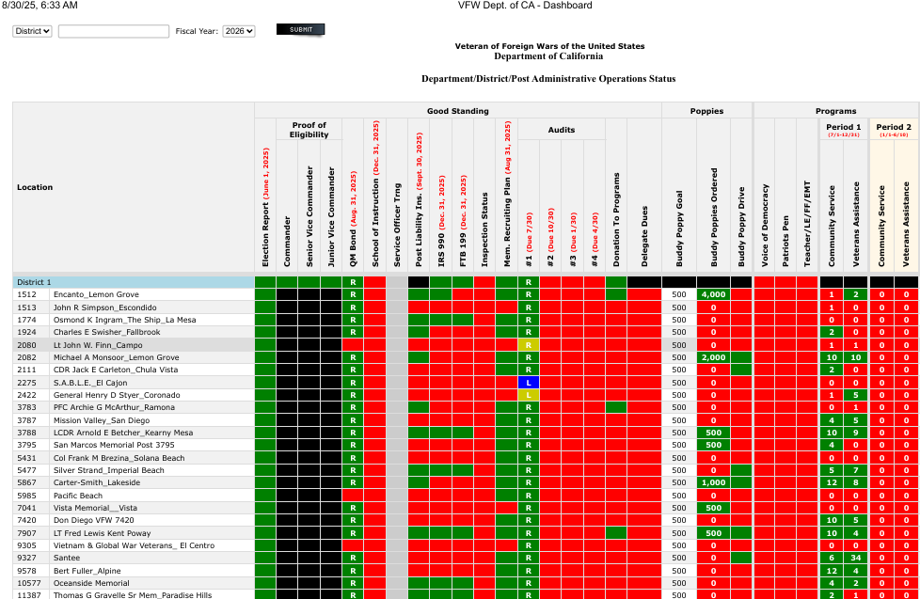

Slide 8

Post Commander – VFW Duties and Obligations

Slide 9

National Bylaw's, Sec. 218 -
Officers and Chairmen, Duties and Obligations.
Post officers, elected and appointed, and chairmen, shall have such duties as are prescribed in these bylaws and in the Manual of Procedure. As PC, it is your responsibility to know everyone’s job!
If every Post Officer were familiar with their duties and responsibilities and their limitations - and carried out their duties to the best of their ability - there would be very few squabbles within a Post and none which would require outside intervention.

Slide 10
The National Manual of Procedure specifically lists certain duties for each officer, and in the normal course of events, this would be sufficient.
But your Post has its own BYLAWS and may lay out additional, more specific responsibilities for all officers, it is your job to know and understand all of them.
READ YOUR POST BYLAWS
Yes, you will hear this throughout this training,
A LOT!

Slide 11
National Bylaw's, Sec. 218 -
Officers and Chairmen, Duties and Obligations.
Post Commander
Among the duties of a Post Commander, the Commander shall:
Preside at all meetings of the Post, conducting such meetings in accordance with Article X of the Bylaws and Manual of Procedure and other applicable parliamentary rules. Yes, you must go to all meetings.
Enforce strict observance of the laws and usages of this organization, including Post, District and Department Bylaws and the Congressional Charter, National Bylaws, Manual of Procedure and Ritual and all lawful orders from proper authorities. Read and follow By-laws
Notes:
Presenter
2020-08-20 03:13:22
--------------------------------------------
Hold Up Roberts Rules of Order.

Slide 12
Insist that Post business and activities be conducted in such a manner that they do not violate any applicable governmental law, ordinance or regulation nor bring or tend to bring dishonor or embarrassment upon the Post, its members or the Veterans of Foreign Wars of the United States. Follow the law, don’t embarrass the VFW! Unfortunately, this is why we have a harassment & ethics policy.
Decide all questions of law and usage in the Post, subject to appeal pursuant to the Bylaws.
Appoint all other officers, committee chairmen and committees not otherwise provided for. The Commander may remove such appointed officers, committee chairmen and committees at their pleasure. If they are not doing their job you can get someone that will.

Slide 13
Work with your Quartermaster!
Approve all disbursements of funds properly authorized by the Post. You are responsible to know what your QM is doing.
Assure that the office of Quartermaster is bonded according to Section 703 of the Bylaws.
Assure that all dues and other monies due the National Headquarters and Department are forwarded promptly together with accurate reports and returns pertaining thereto.
Assure that all reports are correctly prepared and promptly forwarded, that all the business of the Post is handled with dispatch and that all necessary licenses and permits are obtained for proper operation.

Slide 14
Ensure that a properly completed Report of Election of Officers for the ensuing year is submitted to Department and National Headquarters by June 1.
Assure that the Post Trustees have examined the books and records of the Post and prepared the Post Trustees Quarterly Report of Audit no later than the end of the month (30th!) following the last day of each quarterly period.
Assure that the Commander or their representative attend all properly called District Conventions or meetings. You attend meetings, here it is again! We are kinda serious about this one.
Notes:
Presenter
2020-08-20 03:13:22
--------------------------------------------
When we talk about reports here we are referring to but not limited to Trustee’s Quarterly Audits, Post Inspections, Community service, ALL committee reports and of course Report of Election. Commanders will be a member of All Committees – May not be the Committee Chairmen but a member nonetheless.

Slide 15
Comply with and perform all duties required by the laws and usages of this organization, the provisions of these bylaws, the Manual of Procedure and Ritual and Department, District, or Post Bylaws pertaining to the duties and obligations of a Post Commander and lawful orders from proper authority and perform such other duties as are usually incident to the office. Again, know the rules, follow the rules. Sometimes we FEEL things should be a way, but it isn’t about feelings, we have rules for reasons.
Be an ex-officio member of all committees. It’s your Post, they are your committees. Know what is going on.

Slide 16

Post Commander Authority
Their authority extends to the Post Home or Club to the extent of enforcing the rules of the Post and the National and Department VFW and public laws.
They represent the authority of the Post between meetings, and their voice is that of the Post membership.
THE POST COMMANDER IS NOT A DICTATOR
This Photo by Unknown Author is licensed under CC BY

Slide 17
Post Commander Participation
They should sit in with the Trustees at their audits or, at least, have a sufficient knowledge of their procedure to know whether they are doing their job.
They should attend the meetings of the House Committee, calling to their attention any discrepancies he/she may have observed or complaints they may have received.
The Commander is the arbitrator of arguments and the judge in disputes. As a general rule, their decisions are considered correct until over-ruled by the Post meeting, the District, Department Commander or Commander-in-Chief.

Slide 18
The Post Commander sets the tone for the Post!
Show up – Listen – Lead
Ask for Help when Required &
You will be successful!

Slide 19
Trainings and Resources
National VFW Training and Support - many tools and resources designed to help you to help lead - https://vfw.org/my-vfw/vfw-training-and-support
Department Reports - https://vfwca.org/di/vfw/v2/default.asp?nid=10&cmr=CACSR#c
25-26 Commanders Guide - https://vfwca.org/uploads/Documents/CDRGuide.pdf

Slide 20
SOI Instructor Points of Contact
Alexis Henshaw
Post Commander, Judge Advocate, Canteen/House Committee
  alexishenshaw@hotmail.com
  (402) 289-7926
DJ Henshaw
Post Quartermaster, Trustee, Adjutant
  henshawdj@gmail.com
  (402) 289-7961
Wendy Calderon
Parliamentary Procedures
  anchorwmc30@gmail.com
  (619) 259-9727

