Slide 1

Veterans of Foreign Wars
Department of California
VFW Mighty 1st District
POST QUARTERMASTER

Slide 2
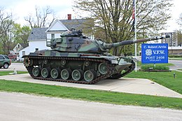

What is a VFW Post Quartermaster?
The Post Quartermaster is:
  The Chief Financial Officer
  Custodian of Post funds and property
  Only one authorized to receive, handle, and account for funds
  Treasurer of all committees handling funds
Notes:
Presenter
2020-08-20 03:12:23
--------------------------------------------

Slide 3
Duties of the Post Quartermaster
The duties are set forth in the National Manual of Procedure, Section 218(a)(5)
Qualify and secure a bond equal to liquid assets.
Collect all money, secure all property, be the accountable officer of the Post and Treasurer on committees.
Disburse funds as properly authorized by the Post using accepted banking practices.
Receive and pay membership dues.
Provide Post Trustees all documents needed to conduct the quarterly audit.
Notes:
Presenter
2020-08-20 03:12:24
--------------------------------------------
And by all means – If you are Not wearing Pants please do Not Get up unless you turn off your video.

Slide 4
Duties of the Post Quartermaster (Cont.)
Maintain a Relief Fund. (Section 704 of Bylaws and Manual of Procedure)
Reconcile and verify all transactions and maintain books and records in legible, uniform format.
Provide access and transfer all properties of the Post to your successor without delay.
Perform your duties in accordance with the Bylaws and laws and usages of this organization.
Notes:
Presenter
2020-08-20 03:12:24
--------------------------------------------

Slide 5
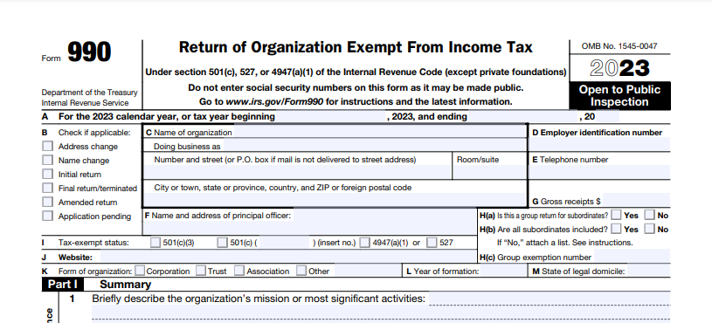
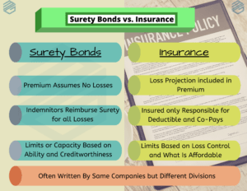
Duties of the Post Quartermaster (Cont.)
Report on receipts and expenditures at regular and special meetings of the Post.
File appropriate forms as required by Federal, State, and Local statutes and regulations.
Notes:
990: https://www.irs.gov/pub/irs-pdf/f990.pdf “Return of Organization Exempt From Income Tax
https://vfwca.org/uploads/Documents/Training/QuartermasterGuidetoFederalTaxInformation.pdf

Slide 6
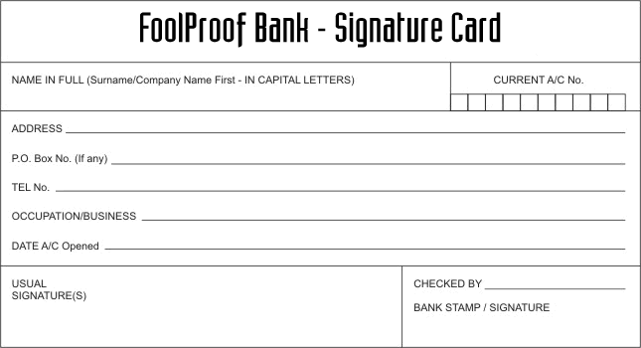
Prior to Taking Over as Quartermaster
Previous QM must be given a “clean slate” by Post Trustees.
Check with bank to determine if funds are correct and in order.
Update bank signature cards.
Make deposits at regular intervals.
Deposit receipts in same physical form as received.
Never pay bills in cash.

Slide 7
Bonds – Accountable Officer(s)
Who needs to be bonded?
  Any and All Post Officers who have access to the Post Funds (on bank signature card).
  The position, not the person is bonded.
How much should you be bonded for?
  Enough to cover liquid assets. Rule of Thumb: Should be slightly more than your quarterly audit total.
How much does a bond cost?
  $4 per thousand with a minimum of $3,000 in coverage. https://vfwca.org/uploads/Documents/Forms/AOStateBondingRates2025-26.pdf
Can I increase my bond coverage?
  Yes, you submit a new application and pay the difference between the two amounts.

Slide 8
Bonds – Club Employees (e.g. Canteen Manager)
Who needs to be bonded?
  Any club employee who is responsible for money. Canteen manager, Bingo Chair.
  The person, not the position is bonded.
How much should you be bonded for?
  Enough to cover what they normally are in custody of until given to QM.
How much does a bond cost?
  $5 per thousand with a minimum of $3,000 in coverage. https://vfwca.org/uploads/Documents/Forms/StateBondingRates2024-2025.pdf
What happens if the Canteen Manager is replaced?
  You will need to submit a new application and pay for a new bond.

Slide 9

Checking Account vs. Fund(s)
Various funds may make up your checking account. Think ‘earmarked’ money for specific purposes
If you have a canteen, you should have a canteen fund.
If you keep cash on hand, you should notate it in funds.
If you have a Lotto machine, you must have it in a separate bank account.
You must maintain a Relief Fund!
VFW Post Checking Account
General Fund
Relief Fund
Scholarship Fund
Post Building Fund

Slide 10
FINANCIAL REPORTING – Quartermaster’s Ledger
The Receipts, Expenditure and Distribution Ledger (Item #4204), also known as the Quartermaster’s Ledger is the most important financial record of the Post.
The ledger should contain the following information:
  The date of the transaction
  Who the transaction is associated with
  The reason for the transaction
  Receipt or Check number
Notes:
Presenter
2020-08-20 03:12:25
--------------------------------------------
Many younger veterans have made statements to the fact that why don’t the VFW do things to help Veterans like other organizations do instead of pushing membership and programs. Other statements heard, we don’t want to run bars or sit around drinking, we want to volunteer to help other Veterans who really need the help. When the VFW was founded it didn’t have bars or canteens and it did in fact Foster camaraderie …. When you look at other Veterans organizations such a Wounded Warrior, Team RWB, SVA, etc… You see organizations that are helping in Specific ways. As I learned a few months ago, some organizations, maybe some of these, obtain funding through different government agencies to help them do what they do – they have to follow the government guidelines for the specific service/treatment they perform in order to get the funding and that’s great. But what they don’t do is advocate for Veterans Full time to secure more health, education and other benefits all Veterans and their families deserve. Only a handfull have the capability to assist Veterans and their families in filing disability claims and NONE are at the capacity of the VFW. That my friends is What the VFW does. We demand results from our government for those who fought for this country. This all comes with a price and it’s not cheap so that’s why we push Membership as hard as we do. The VFW receives NO GOVERNMENT FUNDING to do what we do. Does that stop a Post from doing a food drive, building a deck for a disabled Veteran, or having a family outing event? No! We encourage and preach that with our community service and scholarship programs.

Slide 11
Quartermaster’s Ledger (cont.)
  Cash and Bank represents to amount of the transaction. Funds received are entered in the Received column and funds paid out go in the Expended column.
  The next columns will be your Post’s line-item funds:
    Dues
    General Fund
    Relief Fund
    Canteen
    Etc.

Slide 12
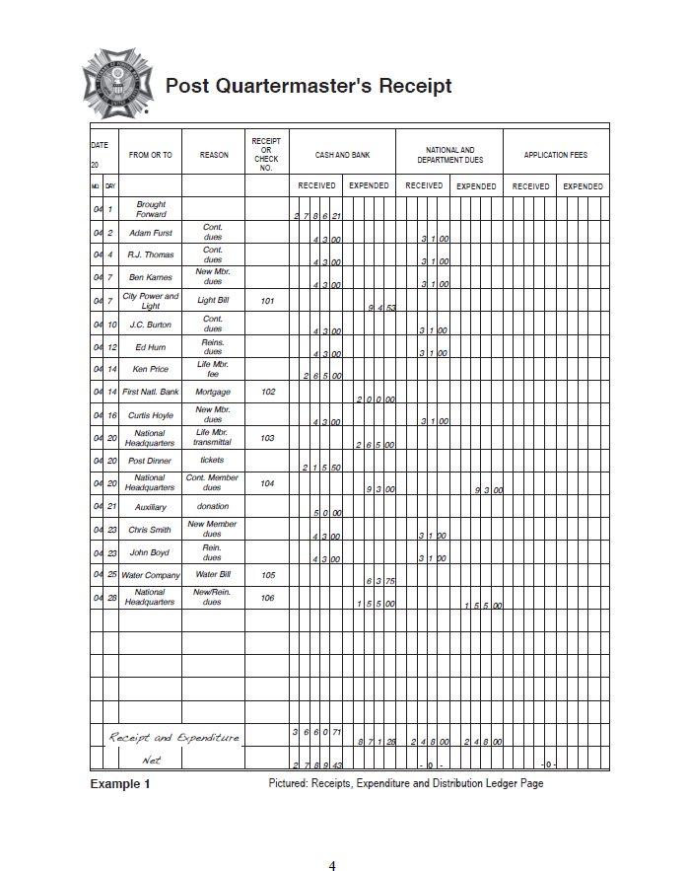
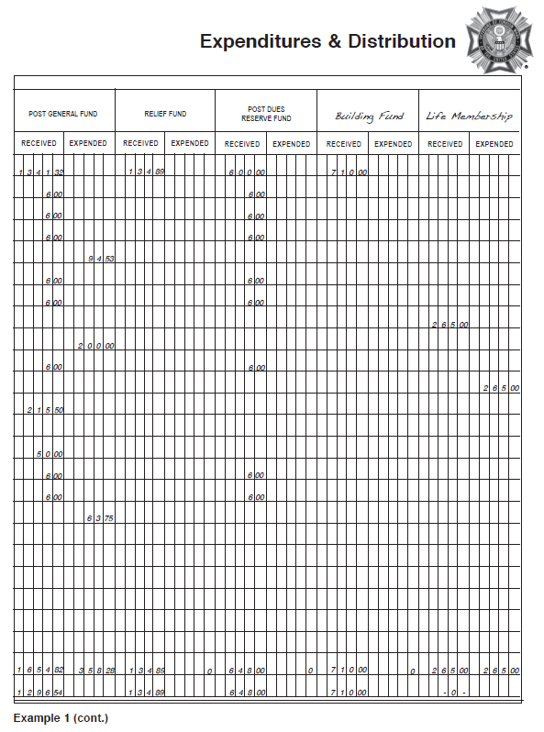
Quartermaster’s Ledger (cont.)
  Fund Line-Items (cont.)
    Each of the individual line-items should have Receipts and Expenditures /Disbursements columns.
    These amounts should match what has been deposited or dispersed on the bank statement and correspond to the specific fund line item(s) voted out at your monthly Post Meeting.

Slide 13
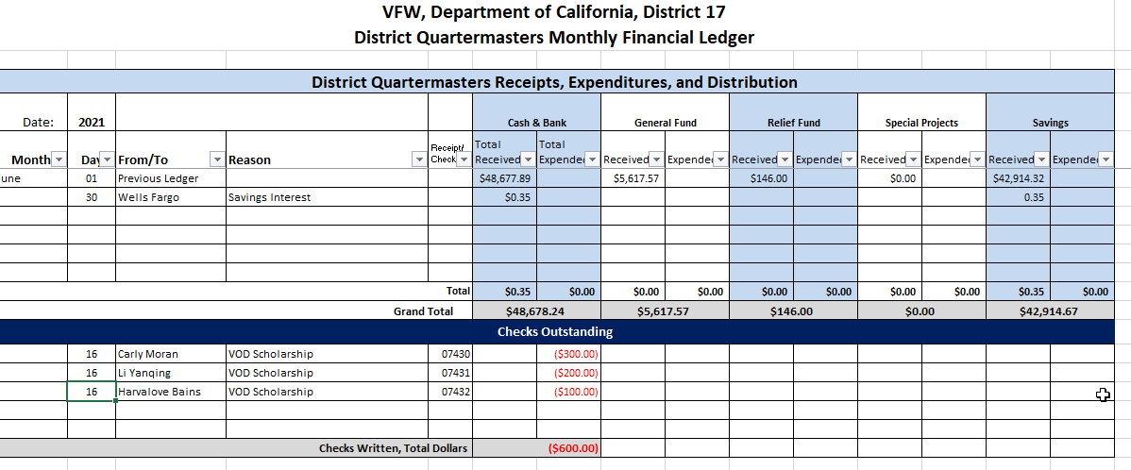
Quartermaster’s Ledger – Excel Sample

Slide 14
Detail of Receipts and Disbursements
This is commonly referred to as the Quartermaster’s Monthly Report:
  Not intended to replace the Quartermaster’s Ledger
  Assists in providing Post Trustees and Post Adjutant a continuous record of financial operation
  Provided to the Trustees for review and audit
  Assists Post Trustees in completing the quarterly audit.

Slide 15
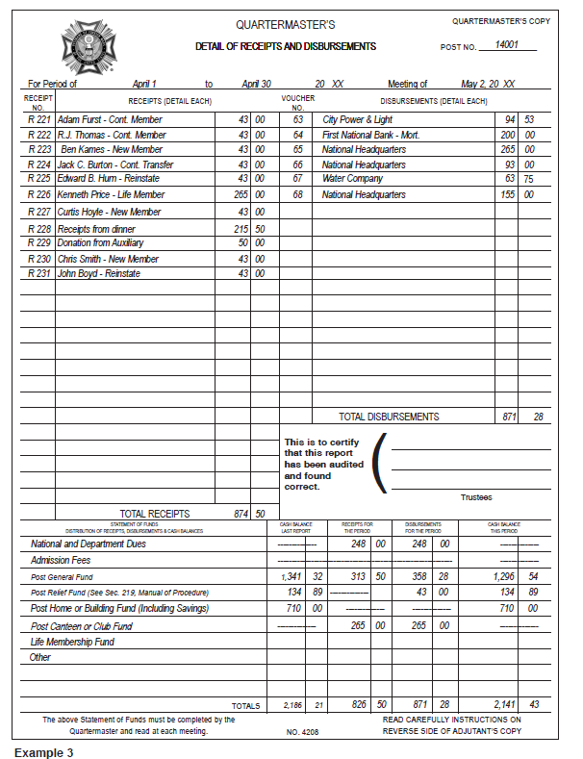
Monthly Financial Statement - Sample

Slide 16
Checks & Balances
Use the Quartermaster’s Ledger, bank statements and compare with the Quartermaster’s Monthly Report as a Check and Balance.
Vs.

Slide 17
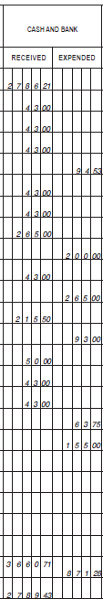
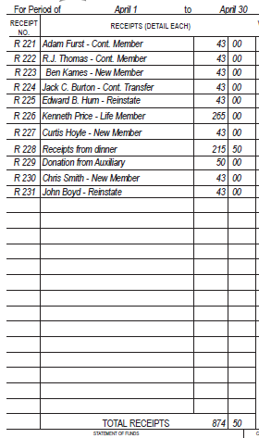
Checks & Balances (cont.)
The Ledger Cash and Bank Received must match Monthly Total Receipts

Slide 18
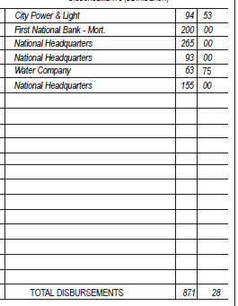
Checks & Balances (cont.)
The Ledger Cash and Bank Expended must match the Monthly Total Disbursements

Slide 19
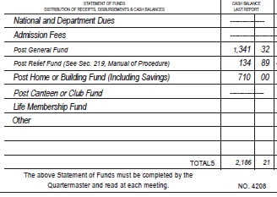
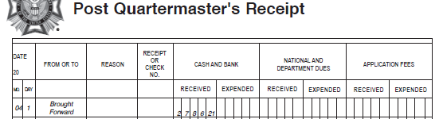
Checks & Balances (cont.)
The Ledger totals brought forward must match the Monthly the Cash Balance Last Report

Slide 20
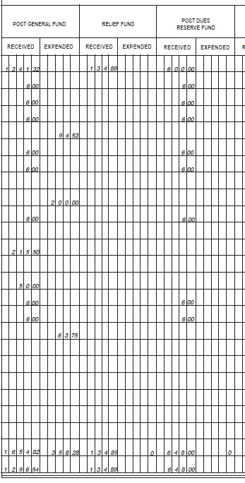
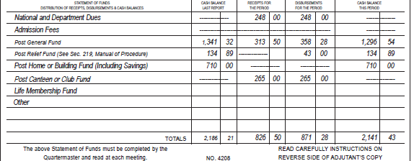
Checks & Balances (cont.)
The Ledger line-item Received, Expended, and Totals must equal the Monthly Receipts, Disbursements, and Cash Balance This Period for each individual line-item.

Slide 21

Electronic Bookkeeping
Record keeping by electronic means may be used, provide a back-up is maintained.
Some common programs are:
  QuickBooks
  EO Software - https://www.eosoftware.com/
  Excel

Slide 22
Important Dates to Remember
Surety Bond Renewal
  No later than August 31st
IRS 990 and FTB 199 (taxes)
  No later than the 15th day of the 5th month following the end of your fiscal year. Normally November 15th.
RRF-1 (If incorporated as a Public Benefit Corporation)
  No later than the 15th day of the 4th month following the end of your fiscal year. November 15th.
Quarterly Audit
  Within 30 days following the end of the quarter.
Notes:
FTB 199: https://www.ftb.ca.gov/forms/2022/2022-199.pdf “California Exempt Organization FORM 2022 Annual Information Return”
RRF-1: https://oag.ca.gov/system/files/media/rrf1_form.pdf - Registry of Charitable Trusts ANNUAL REGISTRATION RENEWAL FEE REPORT TO ATTORNEY GENERAL OF CALIFORNIA

Slide 23
References
Training and Forms
  www.vfw.org – VFW National
  www.vfwca.org – VFW Department of California
Taxes
  990-N (post card)
    https://www.irs.gov/charities-non-profits/annual-electronic-filing-requirement-for-small-exempt-organizations-form-990-n-e-postcard
  199-N (post card)
    https://www.ftb.ca.gov/file/business/types/charities-nonprofits/199N.asp
Charitable Trust Renewal (RRF-1)
  https://oag.ca.gov/system/files/media/rrf1_form.pdf
Notes:
https://www.irs.gov/charities-non-profits/annual-electronic-filing-requirement-for-small-exempt-organizations-form-990-n-e-postcard
https://www.ftb.ca.gov/file/business/types/charities-nonprofits/199N.asp

Slide 24

QUESTIONS

Slide 25
SOI Instructor Points of Contact
Alexis Henshaw
Post Commander, Judge Advocate, Canteen/House Committee
  alexishenshaw@hotmail.com
  (402) 289-7926
DJ Henshaw
Post Quartermaster, Trustee, Adjutant
  henshawdj@gmail.com
  (402) 289-7961
Wendy Calderon
Parliamentary Procedures
  anchorwmc30@gmail.com
  (619) 259-9727

