Slide 1

Veterans of Foreign Wars
Department of California
VFW Mighty 1st District
POST TRUSTEE

Slide 2
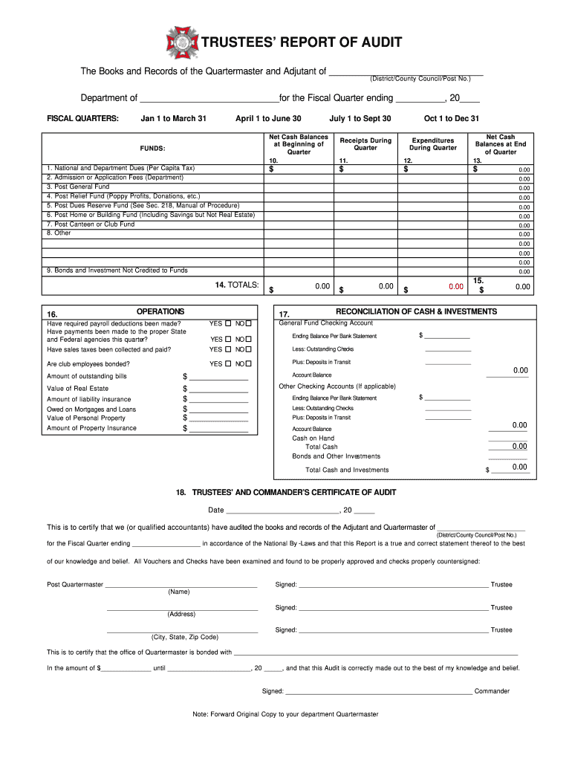

What is a Post Trustee?
The Post Trustee is:
  The reviewer of Quartermaster and Adjutant records
  First line of defense against embezzlement
  Not allowed to serve on a committee whose records are audited
  Elected to a three-year term (e.g. Trustee 3yr → 2yr → 1yr)
Notes:
Presenter
2020-08-20 03:12:23
--------------------------------------------

Slide 3
Duties of the Post Trustee
The duties are set forth in the National Manuel of Procedure, Section 218(a)(11)
Review Monthly Report of Receipts and Expenditures.
Complete a full audit within 30 days .
The audit shall be in accordance and on an Adjutant General approved form.
Perform other duties as may be required.
Notes:
Presenter
2020-08-20 03:12:24
--------------------------------------------
And by all means – If you are Not wearing Pants please do Not Get up unless you turn off your video.

Slide 4

Audit Concerns to Watch out for
Deposits of only a portion of the proceeds
Check stubs payable to someone else and check made out to QM
Securing personal loans with a Post check
Fake Bank statements / Fake break-ins
Collection of dues or raffle money, but not deposited
Cashed Post bonds/investments, pocketed the money
Paid personal credit cards with Post funds or used Post checking account or credit card for personal use.
Notes:
Presenter
2020-08-20 03:12:24
--------------------------------------------

Slide 5
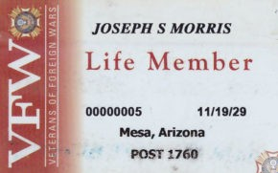

Danger Signs
Stalling with getting books ready
Slowness in paying bills or delay in depositing
Carrying large amounts of “Cash on Hand”
Incorrect information on checks
Complaints from “Members” who haven’t received ID card or magazine
Uncleared checks
Lifestyle changes of the QM

Slide 6
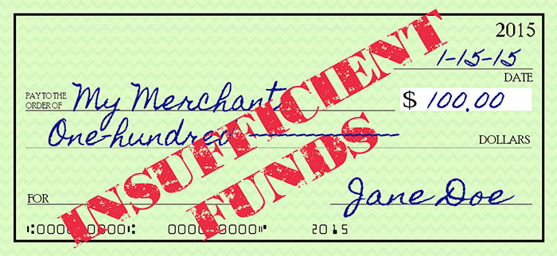
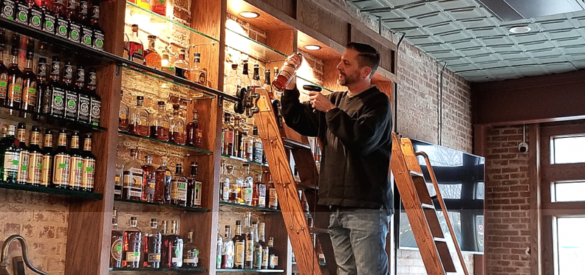
Canteen Issues
Padded liquor inventory
Bad or fictitious checks made out to “Cash”
Leakage of petty cash
Padded payroll
Bootlegging on the side
Kickbacks from suppliers
Gambling operations on the side

Slide 7
Current Legal Proceedings
Former VFW Quartermaster Pleads Guilty to Wire Fraud / Embezzlement April 2025
  Between 2022-2024 $1.7M in Unauthorized Withdrawals
  Falsified bank statements, accounting statements and financial records
  Subject to 20 years in Prison & a $250,000 fine in addition to restitution
Former Quartermaster Indicted in Theft From Central Ohio VFW Post
March 2024
  Check Writing Scheme - $35,000 (memo “Helping Veterans in Need”)
  Federal Indictment. Theft occurred over the period of two years
VFW ‘Secretary/Treasurer’ Charged with Theft
April 2024
  Post Credit Card for Personal Use - $12,000
  Plane Tickets, Hardware Store Purchases, Vehicle Registration over the span of seven (7) months
Notes:
Sources:
https://www.justice.gov/usao-wdok/pr/former-vfw-commander-pleads-guilty-wire-fraud#:~:text=OKLAHOMA%20CITY%20%E2%80%93%20Yesterday%2C%20MICHAEL%20BRUCE,by%20Information%20with%20wire%20fraud.
https://www.ohioattorneygeneral.gov/Media/News-Releases/March-2024/Former-Quartermaster-Indicted-in-Theft-From-Centra
https://www.youtube.com/watch?v=R9IjOaubCQc

Slide 8

Complete Audit of Club Operations
Regular, monthly inventory taken by House Committee
Dated cash register tapes for each day (POS printout)
Day sheet of bar sales for each day
Check stubs, cancelled checks, bank statements
Receipts for all bills paid in cash
Records of all stock purchases
Accounting for income from all non-bar sources

Slide 9
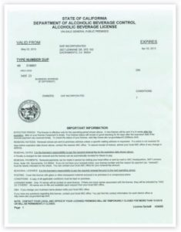
Complete Audit of Club Operations (Cont.)
Completed federal and state payroll tax forms
Payroll records
All licenses and permits
All bills and vouchers
List of unpaid bills
Other records as necessary

Slide 10
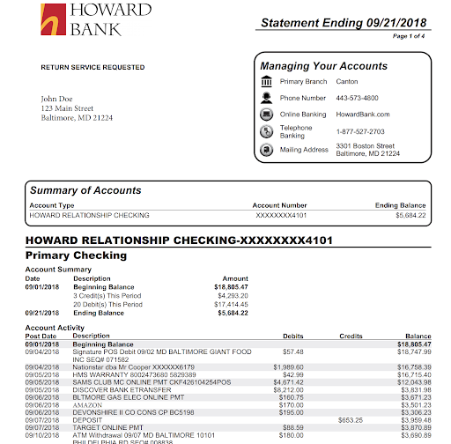
Completing the Quarterly Report of Audit
Documents you will need to complete the audit:
Last quarter’s audit
The three Quartermaster’s Monthly Reports for the quarter
Quartermaster’s Ledger
Statements
  Checking Account(s)
  Savings
  Investments
Tax filings

Slide 11
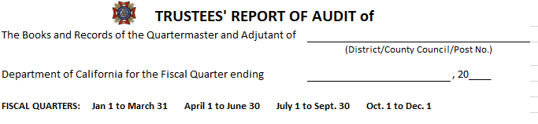
Complete the top with the correct Post Number and date of the Fiscal Quarters end. You can add the District number to the end of you Post number if you want.

Slide 12
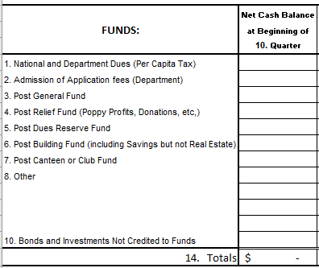
The FUNDS should already be set by the Post Quartermaster.
Take the previous quarterly audit and write the ending balances for each fund as the beginning balance for this audit.

Slide 13
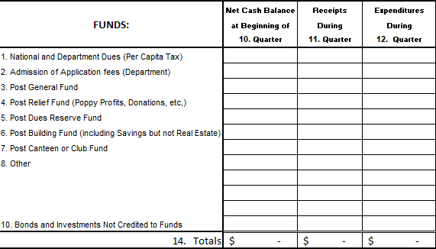
If you have been reviewing the Quartermaster’s Monthly Reports, all you need to do is add up the 3 monthly reports’ receipts and expenditures for each fund and notate the sum in the appropriate column.

Slide 14
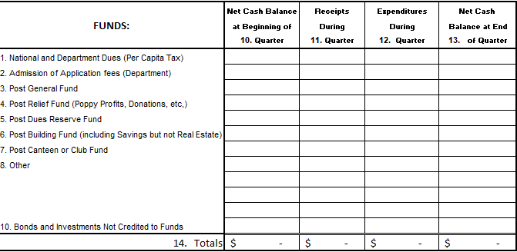
Next, take your starting Fund balance, add your receipts, subtract your expenditures and the total will be your ending balance.
You need to add each column also to note totals in Boxes 14 and 15.

Slide 15
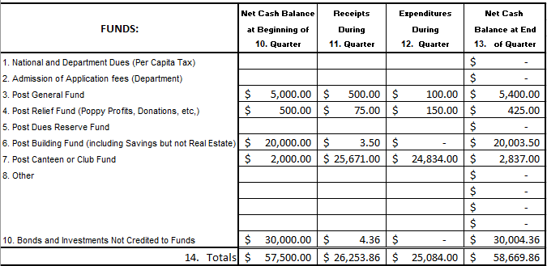
Example

Slide 16
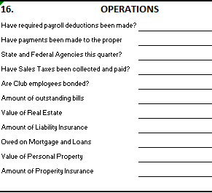
Check payroll records and State and Federal tax filings to ensure payroll tax, use tax, and sales tax has been paid.
The bottom part of Box 16 should remain constant for the year.

Slide 17
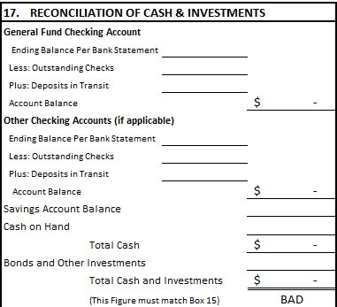
Next you will enter the ending balance of the main checking account for the last day of the quarter.
Then enter any outstanding checks or deposits in transit.
This will give you your account balance.

Slide 18
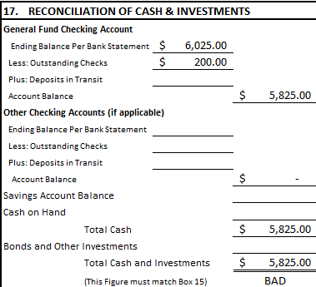

Slide 19
Next, if you have a separate checking account for the canteen (recommended), you will complete the same as the General Fund Checking Account.

Slide 20
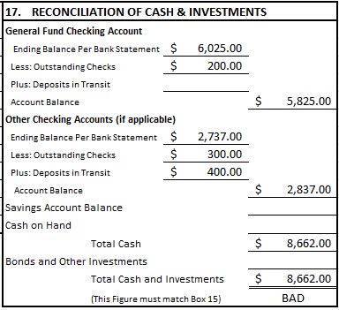

Slide 21
Lastly, you will enter the amounts from any Savings Accounts and/or Bonds and Investment Accounts.

Slide 22
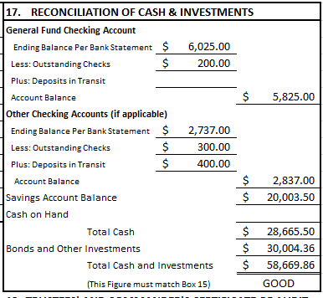
Example of a “Good” Quarterly Audit
If the Quartermaster’s accounting and the bank statements match, then Box 17’s bottom line will match Box 15’s total.

Slide 23
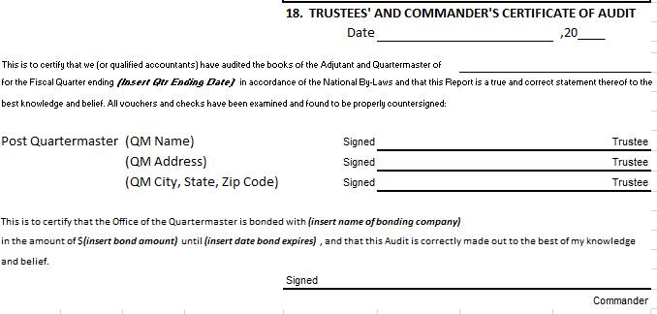
To finalize the audit, the information in Box 18 must be completed which includes at least two (2) Trustee’s signatures and the Post Commander’s signature.

Slide 24
Summary
The Post must maintain a Relief Fund (Section 219)
Column 13, Ending Balance shall not be a negative number
Double check your math
The Checking Account is not only your General Fund
If you keep cash on hand, it should be noted as a FUND line item
You must submit an audit with the appropriate dates/signatures
Be mindful of suspicious activity and report to House Committee

Slide 25

Questions

Slide 26
SOI Instructor Points of Contact
Alexis Henshaw
Post Commander, Judge Advocate, Canteen/House Committee
  alexishenshaw@hotmail.com
  (402) 289-7926
DJ Henshaw
Post Quartermaster, Trustee, Adjutant
  henshawdj@gmail.com
  (402) 289-7961
Wendy Calderon
Parliamentary Procedures
  anchorwmc30@gmail.com
  (619) 259-9727

