Slide 1

Veterans of Foreign Wars
Department of California
VFW Mighty 1st District
POST ADJUTANT

Slide 2
Congratulations
Congratulations on your appointment as a Post Adjutant! Your position is critical for the long-term success for your post.
Your Commander is counting on you to fulfill your duties as required and/or directed.
Remember at all times: You are not alone, you have help to be successful.

Slide 3
Objective of this Training
Identify the tools needed to do your job
Review the duties of a Post Adjutant
  Section 218 – Officers and Chairmen, Duties and Obligations, (6) Adjutant
  Identify other critical documents you may be responsible for
Review Dashboard Reporting
  All State/All American Program Reporting

Slide 4
Tools Needed to Do Your Job
You must have a National vfw.org “Log In” (create an account through Troop
ID if you don’t have access).​
- You must have a Department vfwca.org “Log In” (your membership number and your last name). ​
​
- Access forms, documents, templates, training, General Orders, etc., and the VFW store (must have login).​
​
Your responsibility for reporting and maintaining files are accomplished through these websites.

Slide 5
Duties of a Post Adjutant – Sec. 218 (a)(6)
Be the official corresponding officer for the Post.
Under the Direction of the Commander, prepare all reports.
Delegate Election Report (Department, National): ​
-Completed once a year during convention in April.​
-Delegates are nominated and elected by the membership.​
-One delegate for every thirty members and a fraction thereof.​
-Department form: vfwca.org​
-National form: Provided to the incoming Quartermaster of can be submitted online by the QM only.​
-29% of posts had no minutes or delegate election reports on file.
Program Reports (Department, National)​
-Covered later in presentation

Slide 6
Duties of a Post Adjutant – Sec. 218 (a)(6)
c. Maintain the books and records in a legible and uniform format. Can use electronic means as long as a back-up is available. Books and records shall be available by authorized officers and Post members at reasonable times. Unless authorized by the Post, books and records will be kept at the Post facilities.
39% of posts inspected had missing, unkept records and/or a lack of understanding of the Adjutant’s duties and requirements.

Slide 7
Duties of a Post Adjutant – Sec. 218 (a)(6)
d. The Post Adjutant shall maintain the following records:​
1. A copy of the original application of every member admitted to the Post.​
This is an item on the Post Inspection Report and should be stored in a secure location.
2. Minutes of each Post meeting after correction and approval.
Responsible for the recording of, distribution of, and maintaining a file of the Posts meeting minutes.
Minutes are a record of motions made; including authorization for expenditure of funds (QM Report), nominations and elections of Post Officers and delegates, committee reports, and program reports.
Minutes represent the actions of the Post and are considered legal documents by auditors, the IRS and the courts.

Slide 8
Duties of a Post Adjutant – Sec. 218 (a)(6)
3. All current orders issued by the CIC, National Council of Administration, the Department, District, and Post Commander.
General Orders (Department, National)
National Headquarters Bulletins
4. A correspondence file. ​
Incoming and outgoing correspondence: emails, letters, faxes, business cards, text messages

Slide 9
Duties of a Post Adjutant – Sec. 218 (a)(6)
5. A file containing a copy of the Proof of Eligibility (POE) submitted by post officers pursuant to Section 216.
Elected and appointed officers that are listed on the Post Election Report.​
Must be provided within 30 days of election or appointment.​
IAW National Bylaws, POE's are kept on file for the entire year.
POE's include the DD214 with the qualifying event, medal or hazardous/imminent danger pay and the character of service. Member 4 copy provides best information.
POE's should be given back/disposed of once the term of office ends.
Identified as a major discrepancy on the post inspection reports.

Slide 10
Duties of a Post Adjutant – Sec. 218 (a)(6)
e. Maintain a current copy of the Bylaws, Manual of Procedure and Ritual of the VFW and copies of the Bylaws of the Post, Department and District (properly stamped).​
National Bylaws & MOP can be downloaded from VFW.org website
f. Transfer to their successor, all books, papers, records, monies and other records and property of the post in their possession or under their control.​
g. Comply with and perform all duties required of the Adjutant.
Key member for Post Inspections
Must follow the Document Retention Policy

Slide 11
Post Inspection Responsibilities
5) Does the Post Adjutant...
Maintain books and records in a legible and uniform format?
Maintain a file containing a copy of the original application of every member admitted into the Post?
Maintain a file of meeting minutes after correction and approval?
Maintain a file of current orders or circulars from higher authority?
Maintain a correspondence file?
Maintain a file containing proof of eligibility submitted by officers?
Maintain a current copy of Post, District, Department and National Bylaws?

Slide 12
Other Critical Documents
Articles of Incorporation: The Adjutant must retain the most current and approved Articles of Incorporation. They must have three signatures/stamps on them; VFW Department, VFW Commander in Chief, and the Secretary of State.
Statement of Information (SI-100): Ensure the SI-100 with the Secretary of State is updated every two years or when an election changes those individuals.
-Secretary of State records can be found @: https://bizfileonline.sos.ca.gov/
Recruitment and Retention Plan: 22% of posts inspected did not have a copy of the plan.

Slide 13
Program Reporting
Reportable programs may be found in the Department’s All-State Program and National’s All-American Program (found on respective websites).
Review the guides thoroughly for reporting requirements and due dates as you are responsible for reporting.
All-State requirements are reported online at vfwca.org.
All-American requirements are reported online in OMS at vfw.org.
Samples follow this slide.

Slide 14
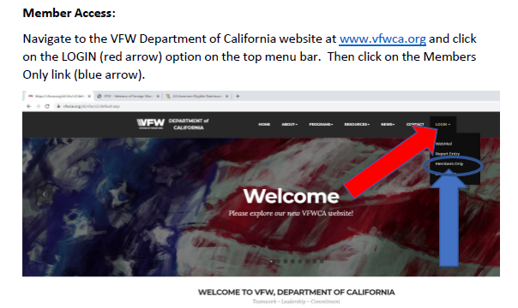
Reporting - All State

Slide 15
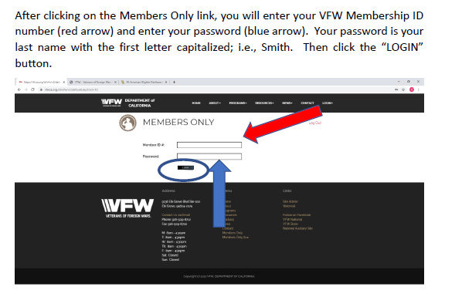
Vfwca.org – Members Only Login

Slide 16
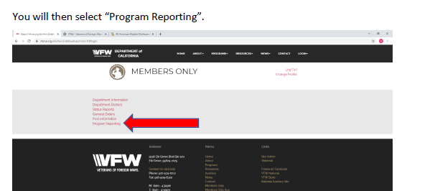
Program Reporting

Slide 17
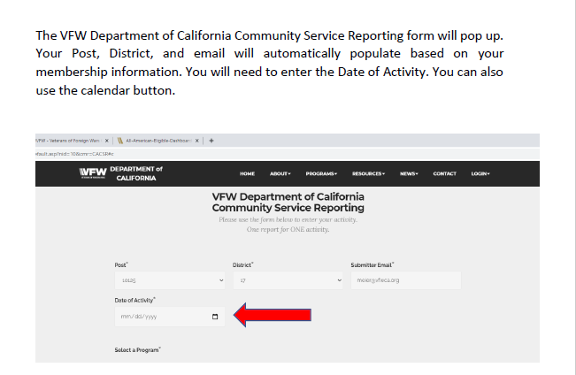
Post/District/Submitter/Date

Slide 18
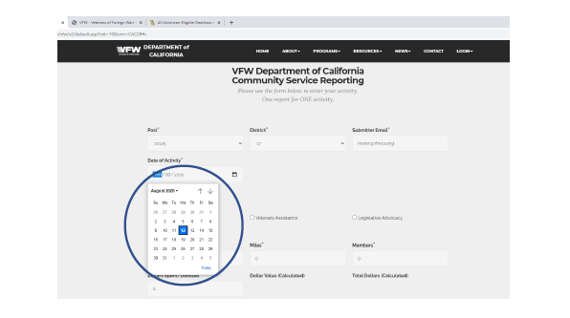
Reporting - All State

Slide 19
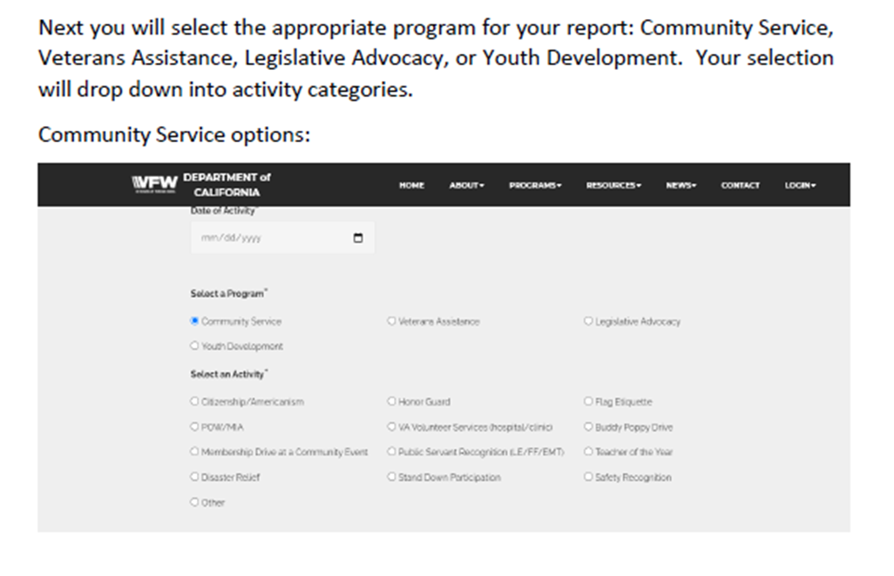
Select a Program – Community Service

Slide 20
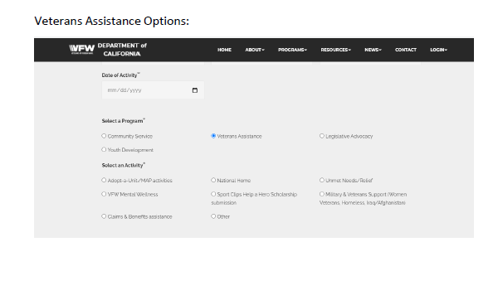
Select a Program – Veterans Assistance

Slide 21
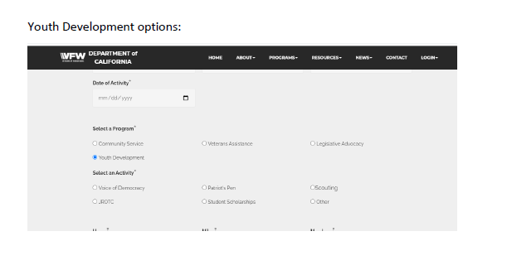
Select a Program – Youth Development

Slide 22
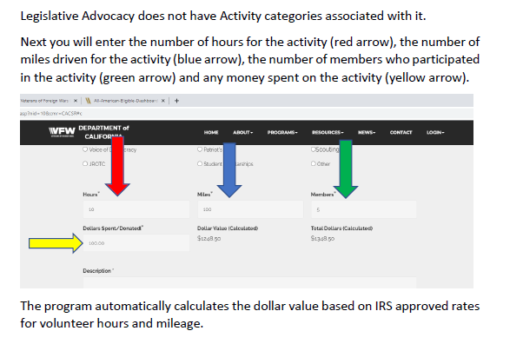
Hours/Miles/Post Members/$$

Slide 23
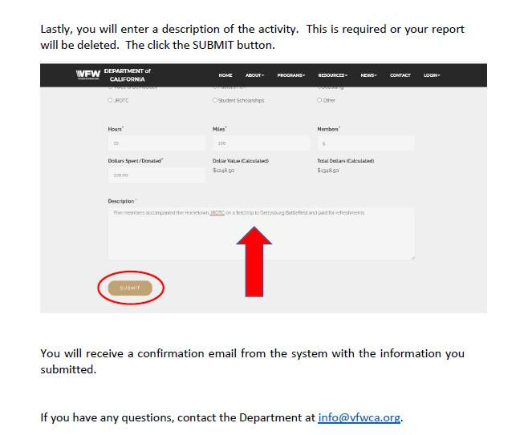
(VERY) Brief Description of Activity

Slide 24
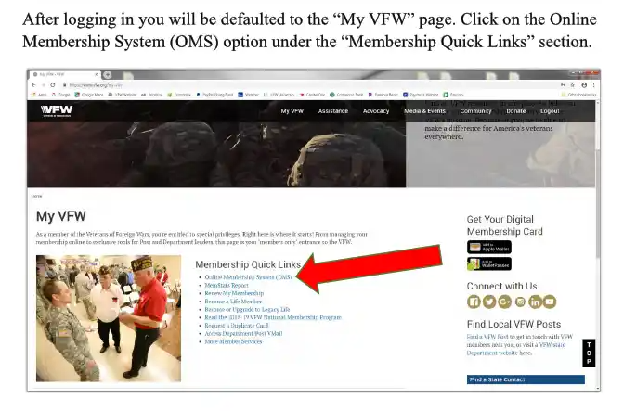
Reporting - All American – vfw.org

Slide 25
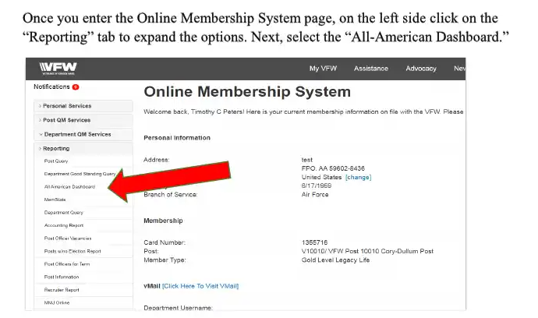
All American Dashboard

Slide 26
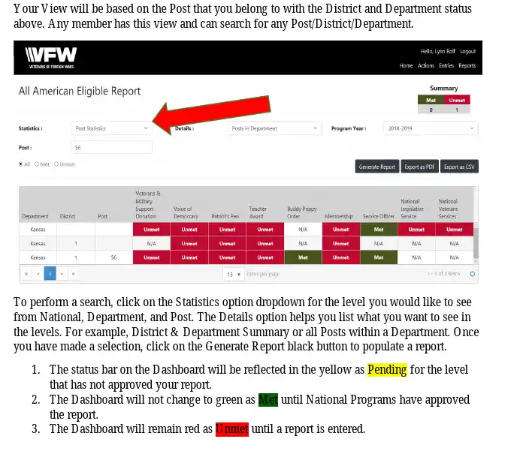
All American Eligible Report (Post Stats)

Slide 27
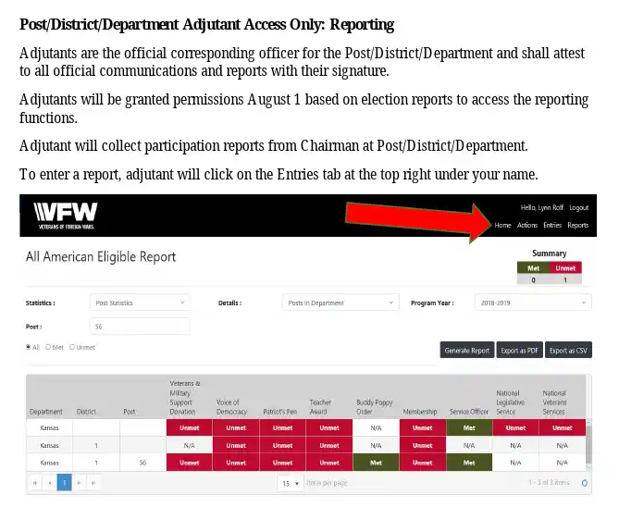
All American Adjutant Only Access

Slide 28
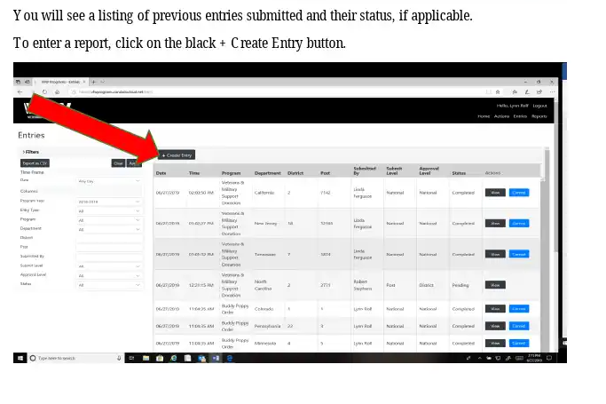
All American – Create Entry

Slide 29
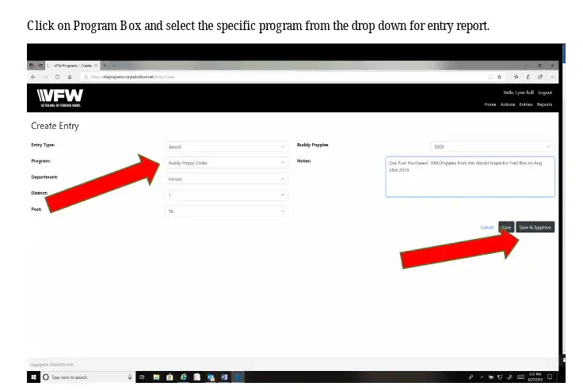
All American – Program Entry

Slide 30
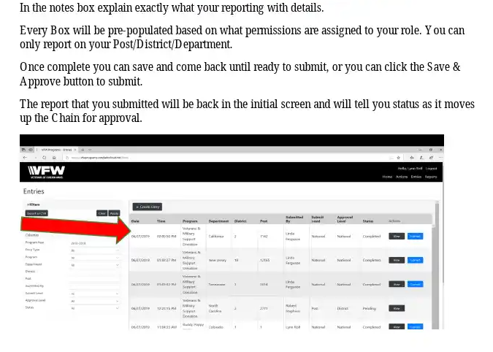
Reporting - All American

Slide 31
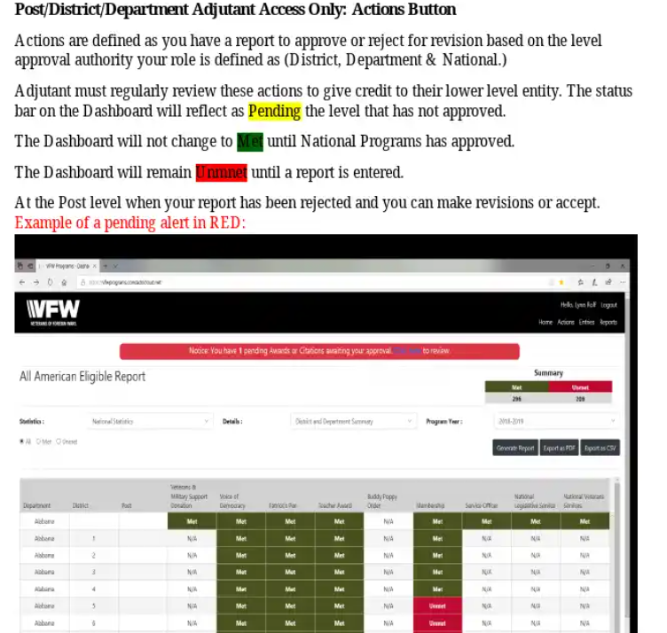
Reporting - All American

Slide 32
Questions?

Slide 33
SOI Instructor Points of Contact
Alexis Henshaw
Post Commander, Judge Advocate, Canteen/House Committee
  alexishenshaw@hotmail.com
  (402) 289-7926
DJ Henshaw
Post Quartermaster, Trustee, Adjutant
  henshawdj@gmail.com
  (402) 289-7961
Wendy Calderon
Parliamentary Procedures
  anchorwmc30@gmail.com
  (619) 259-9727

